Slide 1
Breaking the Slience: AI and Computer Vision Driven Sign Language Translation System
Production Project Module, BSc Computing (Hons), Leeds Beckett University
Sameer Basnet | Student Id: 77356702 | Supervisor: Surammya Sharma | May 2025

Slide 2
Executive SUMMARY
Project Objectives & Goals
To develop a product that accurately detects and recognizes hand gestures in real-time.
Translate recognizes hand gestures into English language for satisfactory communication.
Simple User Interface (UI) that allows users to easily interact with the system and view output.
Integrate Text-to-Speech (TTS) module into the product to convert output text to speech for enhance accessibility of the product for users.
To improve the product robustness, a real-time error handling mechanism will be integrated that provides real time feedback when a gesture is not recognized or detected, ensuring a smooth and user-friendly experience.
Achieve high recognition accuracy (>99%) with end-to-end latency under 200 ms for natural conversation.
Generate an ASL video from user-entered English text using a simple approach without advanced grammar processing.

Slide 3
Problem Statement

Slide 4
Problem Statements
Deaf and hard-of-hearing individuals and hearing users lack a seamless, real-time, bidirectional communication tool.
Existing solutions are predominantly one-way (e.g., speech-to-text captions) or rely on human interpreters, causing delays and high costs.
ASL gesture recognition into spoken or written English in live interactions remains unreliable and limited in availability.
There is no straightforward method to convert typed or spoken English back into ASL video for Deaf users.
Educational, healthcare, and public-service settings suffer from accessibility gaps due to the absence of on-the-fly sign language support.
Current computer-vision and deep-learning pipelines are not yet optimized for sub-200 ms end-to-end latency on consumer-grade hardware.
A scalable, low-cost, and user-friendly platform is needed to bridge this communication divide in everyday and critical contexts.

Slide 5
Project scope
Objective
This project employs computer vision and AI to create a real-time sign language translation system that converts hand gestures into English text speech and vice-versa, empowering deaf and mute individuals to communicate seamlessly.

Slide 6
Key Features
Real-Time Bidirectional Translation
ASL → English: Live hand-gesture capture and conversion into written text and synthesized speech
English → ASL: Typed or spoken English transformed into ASL video sequences
Robust Hand-Landmark Extraction
Uses MediaPipe Hands for 21-point landmark detection at 30+ FPS
Handles occlusions, varied lighting, and complex backgrounds
Attention-Augmented LSTM Model
Processes temporal sequences of landmarks to recognize dynamic ASL gestures
Achieves >99% classification accuracy with sub-200 ms latency

Slide 7
Key features
Natural Language Processing Integration
Cleans and structures English input via a language API (e.g., Gemini)
Ensures grammatical coherence before ASL synthesis
Avatar-Based & Clip-Concatenation Video Output
Generates smooth ASL animations using an avatar or stitched gesture clips
Exports MP4 files for offline viewing or embedding
Web & Mobile-Friendly Interface
Responsive frontend with live camera feed, controls, and transcript display
Text-to-Speech & Speech-to-Text
Leverages Web Speech API for spoken English output and voice input support

Slide 8
KEY FEATURES
Role-Based Access & Security
User roles (e.g., Presenter, Interpreter, Admin) with fine-grained permissions
Audit Logging & Analytics
Timestamped logs of all translation sessions for compliance and quality review
Dashboard for usage statistics, error analysis, and model performance

Slide 9
TARGET USERS
Deaf and Hard-of-Hearing Individuals
Speech-Impaired or Mute Users
Family Members & Caregivers
ASL Interpreters & Translators
Educators & Students
Healthcare Professionals
Public Service Employees

Slide 10
Limitations
Limited Vocabulary & Grammar
Two-Handed & Dynamic Gestures
Environmental Constraints
Latency & Connectivity
Avatar & Video Quality
Context & Ambiguity

Slide 11
Security
Role-Based Access Control (RBAC)
Secure API Layers
Input Validation & Sanitization
Media Stream Protection
Secure Storage & Audit Logging
Strong Authentication & Session Management
Privacy & Compliance

Slide 12
WHAT IS AMERICAN SIGN LANGUAGE(ASL)?
American Sign Language (ASL) is a fully-fledged, natural language used primarily by Deaf and hard-of-hearing communities in the United States and parts of Canada. Key points:
Visual-Gestural Modality
Own Grammar & Syntax
Rich Expressiveness
Regional Dialects
Cultural Identity

Slide 13
Machine Learning Fundamentals
A subfield of AI where algorithms learn patterns from data rather than relying on explicit rules.
Training involves feeding labeled examples (e.g., ASL landmark sequences) into a model and optimizing its parameters (e.g., via gradient descent)
Generalization is key: a well-trained model correctly predicts unseen gestures in real time.
Performance is evaluated using metrics like accuracy, precision/recall, and latency on test data.

Slide 14
Computer Vision Fundamentals
A branch of AI focused on enabling machines to interpret and understand visual data (images & video).
Combines image processing (filtering, edge detection) with pattern recognition to extract meaningful features.
Modern CV relies on Convolutional Neural Networks to learn hierarchical representations directly from raw pixels.
Powers tasks such as object detection, image segmentation, pose estimation, and landmark tracking.

Slide 15
MediaPipe Hands
An open-source, on-device hand-tracking solution by Google that detects and tracks up to two hands in real time.
Extracts 21 key 3D landmarks per hand (joints and fingertips) for fine-grained gesture analysis.
Combines lightweight CV pipelines with machine-learning models for 30+ FPS performance on mobile and desktop.
Offers robustness to partial occlusions, varying lighting conditions, and complex backgrounds.
Provides cross-platform support (Web, Android, iOS, Python) with simple API integration.

Slide 16
Long Short-Term Memory (LSTM)
A specialized Recurrent Neural Network (RNN) architecture designed to capture long-range dependencies in sequential data.
Utilizes memory cells and three gating mechanisms—input, forget, and output gates—to control information flow and mitigate the vanishing-gradient problem.
Cell state acts as a conveyor belt, allowing relevant features to persist across many time steps while irrelevant ones are discarded.
Ideal for tasks involving time-series or ordered data, such as speech recognition, language modeling, and dynamic gesture sequences in ASL.
Proven ability to generalize on unseen sequences, maintaining context over tens or hundreds of frames with stable training.

Slide 17
Why Use LSTM in This Project
Temporal Dependency Modeling: LSTM’s memory cells capture the progression of hand movements across frames, essential for distinguishing dynamic ASL gestures.
Long-Range Context Retention: Gates within LSTM preserve relevant features over extended sequences, handling gestures that span many frames.
Vanishing-Gradient Mitigation: Specialized gating avoids loss of important gradient information during training, ensuring stable learning on longer gesture windows.
Variable-Length Sequence Handling: Easily processes sliding windows of different lengths without requiring fixed-size inputs.
Real-Time Suitability: Efficient inference on sequence data enables sub-200 ms latency, meeting the project’s real-time translation requirements.

Slide 18
Why Use MediaPipe Hands in This Project
High-Fidelity Landmark Detection: Provides 21 precise 3D hand‐joint coordinates per frame, enabling fine-grained gesture analysis.
Real-Time Performance: Runs at 30+ FPS on standard webcams and mobile devices, meeting our sub-200 ms end-to-end latency goal.
Robustness: Handles partial occlusions, varied lighting, and complex backgrounds without extensive preprocessing.
Cross-Platform Support: Easy integration across Web (JavaScript), Android, iOS, and Python environments with a unified API.
Lightweight & On-Device: Minimal compute overhead allows on-device inference, reducing dependence on cloud services and preserving user privacy.

Slide 19
What Is Agile Methodology?
An iterative, flexible approach to software and AI-driven system development.
Work is organized into short sprints, enabling continuous stakeholder feedback and rapid course corrections.
Encourages adaptability to evolving requirements—new ASL signs, UI refinements, and performance optimizations can be incorporated on the fly.

Slide 20
In This Project, Agile Enabled Us To:
Sprint 1: Prototype MediaPipe integration and basic ASL landmark capture pipeline.
Sprint 2: Develop and train the initial attention-LSTM model; validate recognition accuracy.
Sprint 3: Build the real-time ASL→English UI, gather user feedback on latency and transcript clarity.
Sprint 4: Implement English→ASL video synthesis, refine avatar animations based on usability tests.
Sprint 5+: Harden security (RBAC, encryption), optimize inference latency, and iterate on edge-device deployment—all guided by continuous testing and community input.

Slide 21
Tools Used During Project Development
MediaPipe Hands: For real-time detection and 3D tracking of 21 hand landmarks in the video stream.
Python 3.10 & OpenCV: Core language and library for video capture, frame preprocessing, and landmark buffering.
TensorFlow & Keras: Building, training, and exporting the attention-augmented LSTM sequence model for ASL gesture recognition.
PYCHARM: Primary IDE for full-stack development—Python, JavaScript/HTML/CSS, and configuration files.
Django & Django REST Framework: Backend framework exposing RESTful endpoints for ASL→English inference and English→ASL synthesis.

Slide 22
Tools Used During Project Development
Git & GitHub: Version control, branching workflow, code reviews, and CI/CD integration.
Web Speech API: Browser-native text-to-speech (TTS) and speech-to-text (STT) features for English output and voice input.
Figma: UI/UX design tool for wireframing and prototyping the web and mobile interfaces.
MySQL: Relational database for storing user profiles, translation transcripts, audit logs, and system settings.
draw.io: Diagramming tool used to create architecture diagrams, workflow charts, and sequence models.
Gemini API: Natural language API for cleaning, structuring, and grammatical correction of English input before ASL synthesis.

Slide 23
Research Methodology
Literature Review: We surveyed state-of-the-art ASL recognition systems, attention-based sequence models, and real-time hand-tracking frameworks to guide our platform design.
Technology Selection: We selected MediaPipe Hands for landmark extraction, TensorFlow/Keras with an attention-augmented LSTM for gesture classification, Django REST + BOOTSTARP for the full-stack, Web Speech API & Gemini API for NLP, and MySQL for data persistence based on performance and integration needs.
Agile Development: We organized work into two-week sprints with regular stakeholder demos and user feedback loops to iteratively refine accuracy, latency, and UI/UX.
Testing & Validation: We conducted unit tests on model inference and API endpoints, integration tests on end-to-end ASL↔English flows, performance benchmarks to ensure sub-200 ms latency, and user acceptance sessions with Deaf/hearing pairs for real-world usability.
Analysis & Documentation Tools: We used Jupyter Notebooks for data exploration and metric visualization, Postman for API debugging, Git/GitHub for version control, draw.io for architecture/workflow diagrams.

Slide 24
Challenges Faced During Research
Limited ASL Dataset Availability: Procuring a sufficiently large, annotated corpus of dynamic ASL gestures—especially for two-handed signs—was difficult, requiring custom data collection and labeling.
Landmark Detection Robustness: Ensuring MediaPipe reliably tracked 21 hand landmarks under varying lighting, skin tones, and partial occlusions proved challenging and necessitated extensive preprocessing and fine-tuning.
Latency vs. Accuracy Trade-off: Balancing model complexity (attention-augmented LSTM) with the sub-200 ms end-to-end inference requirement on consumer-grade hardware required iterative model and pipeline optimizations.
English→ASL Grammar Mapping: Converting free-form English input into ASL’s topic–comment structure without an advanced NLP engine required simple heuristics and introduced occasional syntactic mismatches.

Slide 25
Challenges Faced During Research
ASL Video Synthesis Quality: Producing smooth, natural-looking sign sequences—whether via avatar animation or clip concatenation—demanded careful timing alignment and transition smoothing.
Signer Variability: Accounting for regional dialects, signing speeds, and individual style differences led to overfitting risks, which we mitigated through data augmentation and regularization techniques.

Slide 26

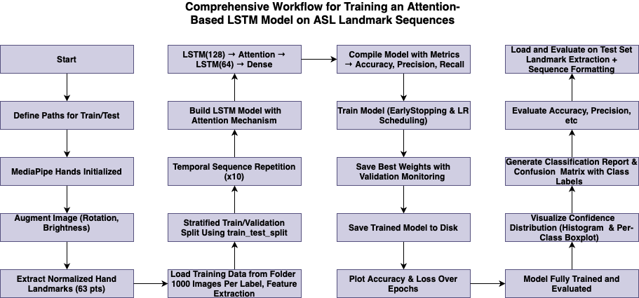

MODEL TRAINING WORKFLOW

Slide 27
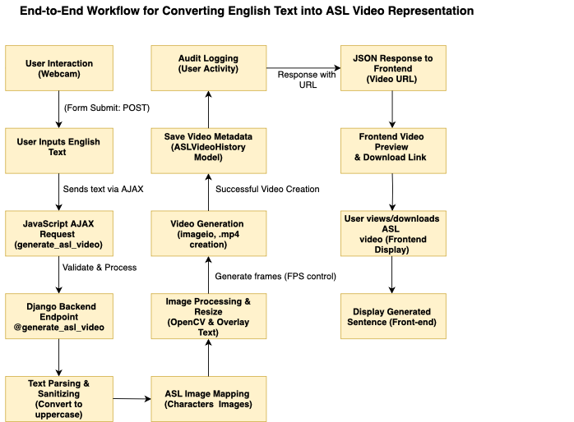
English to asl workflow

Slide 28
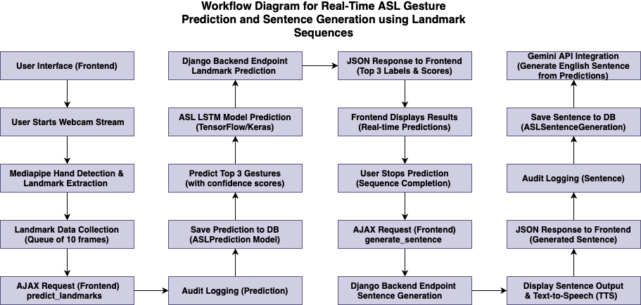
ASL TO ENGLISH WORKFLOW

Slide 29
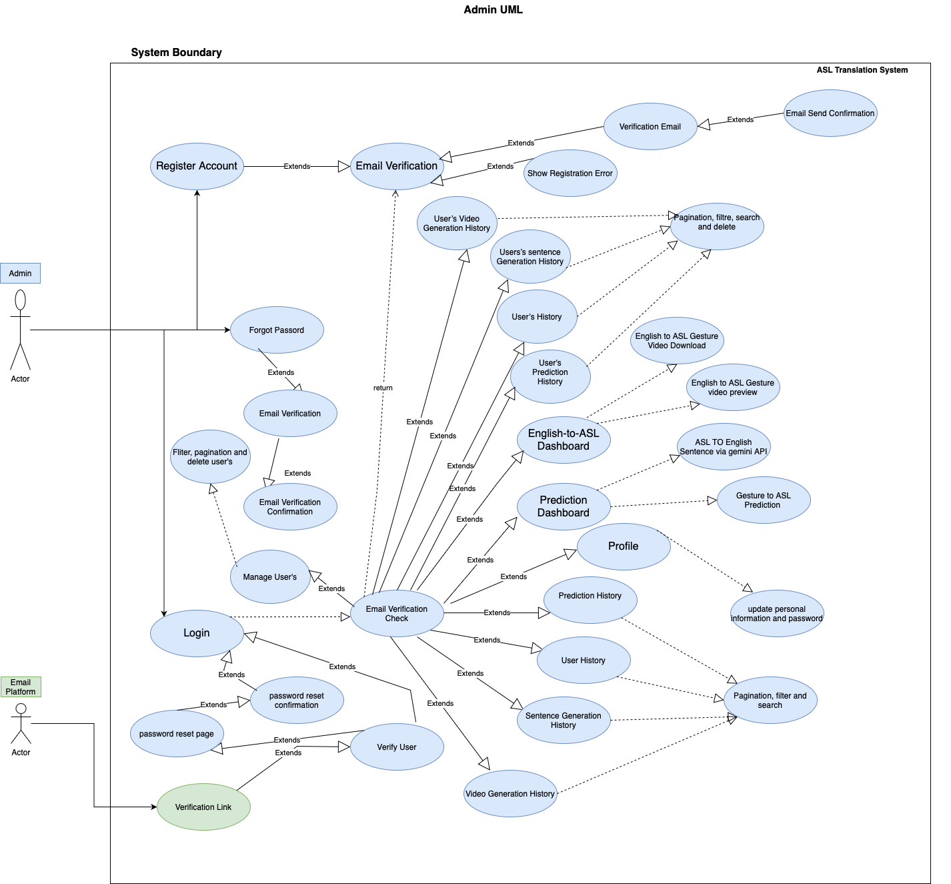
ADMIN USE CASE DIAGRAM

Slide 30
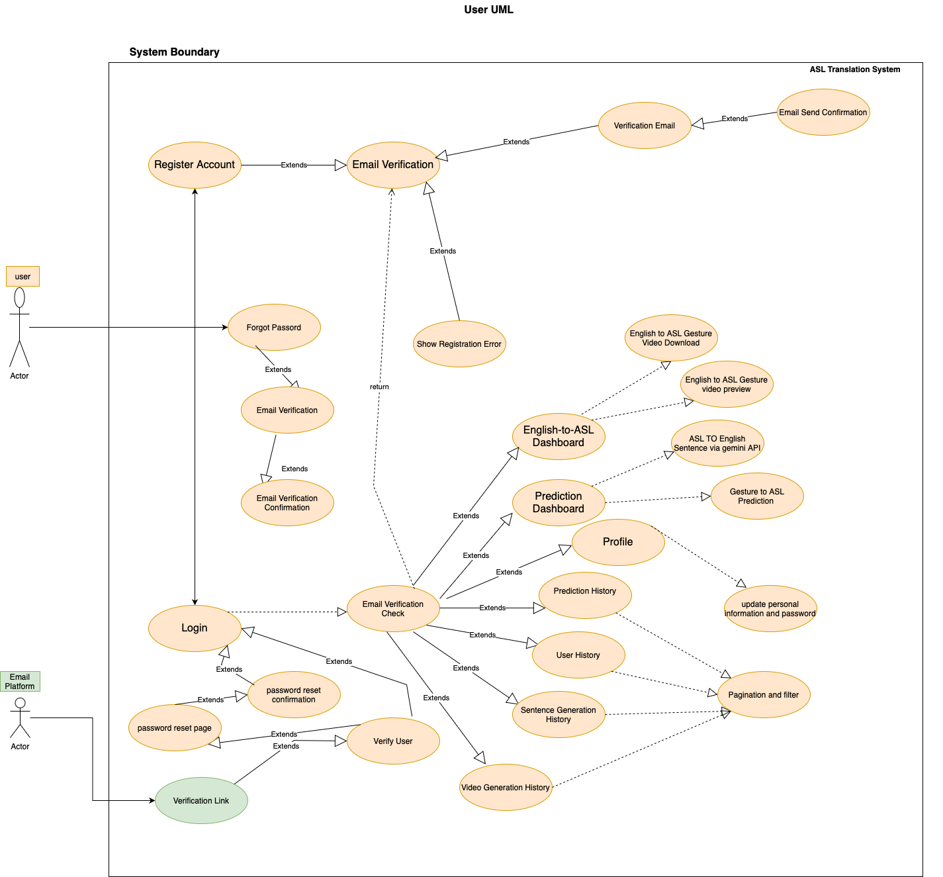
USER USE CASE DIAGRAM

Slide 31
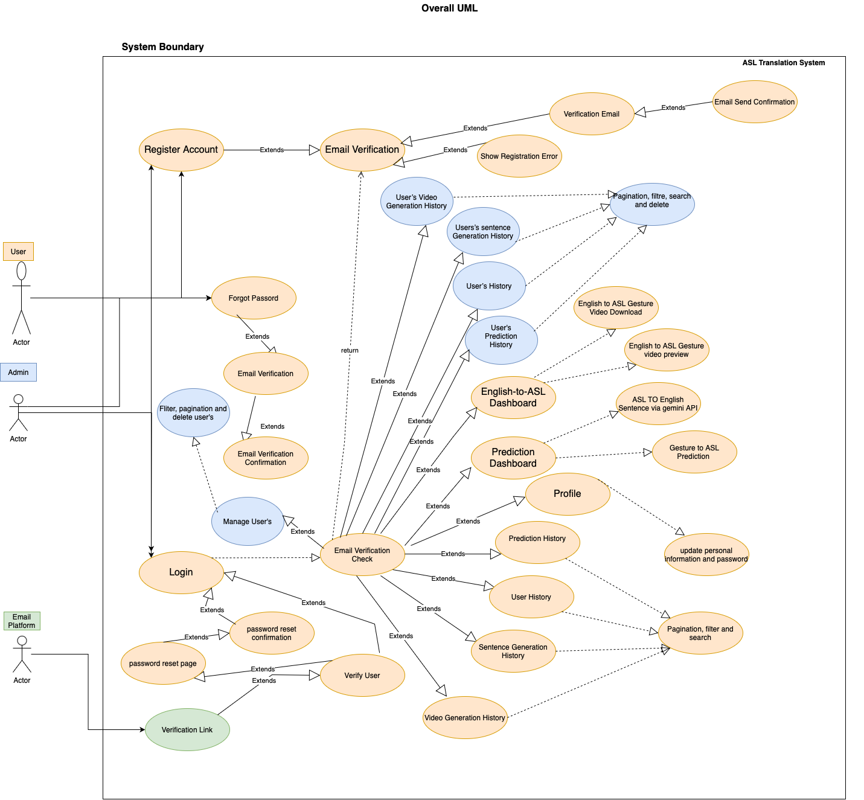
OVERALL USE CASE DIAGRAMS

Slide 32
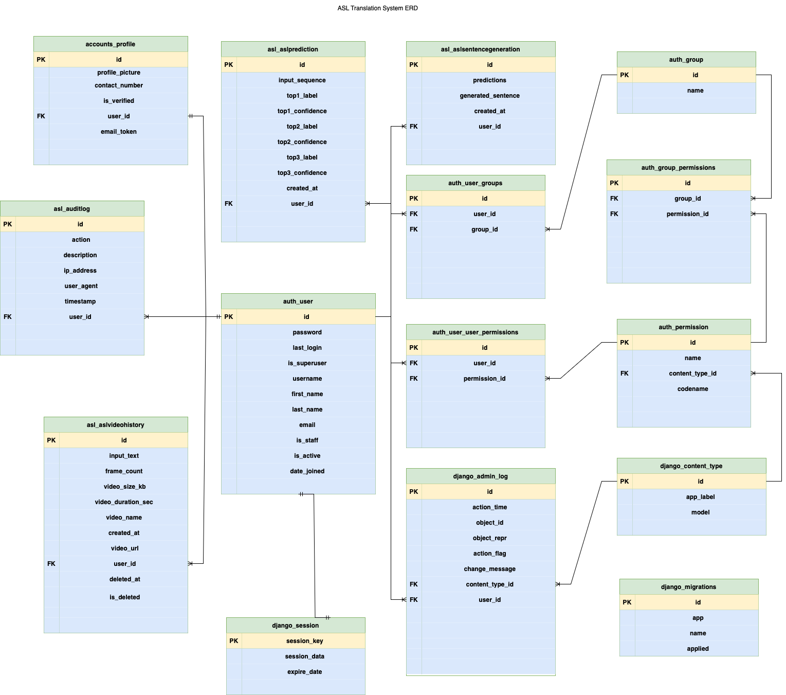
ERD

Slide 33
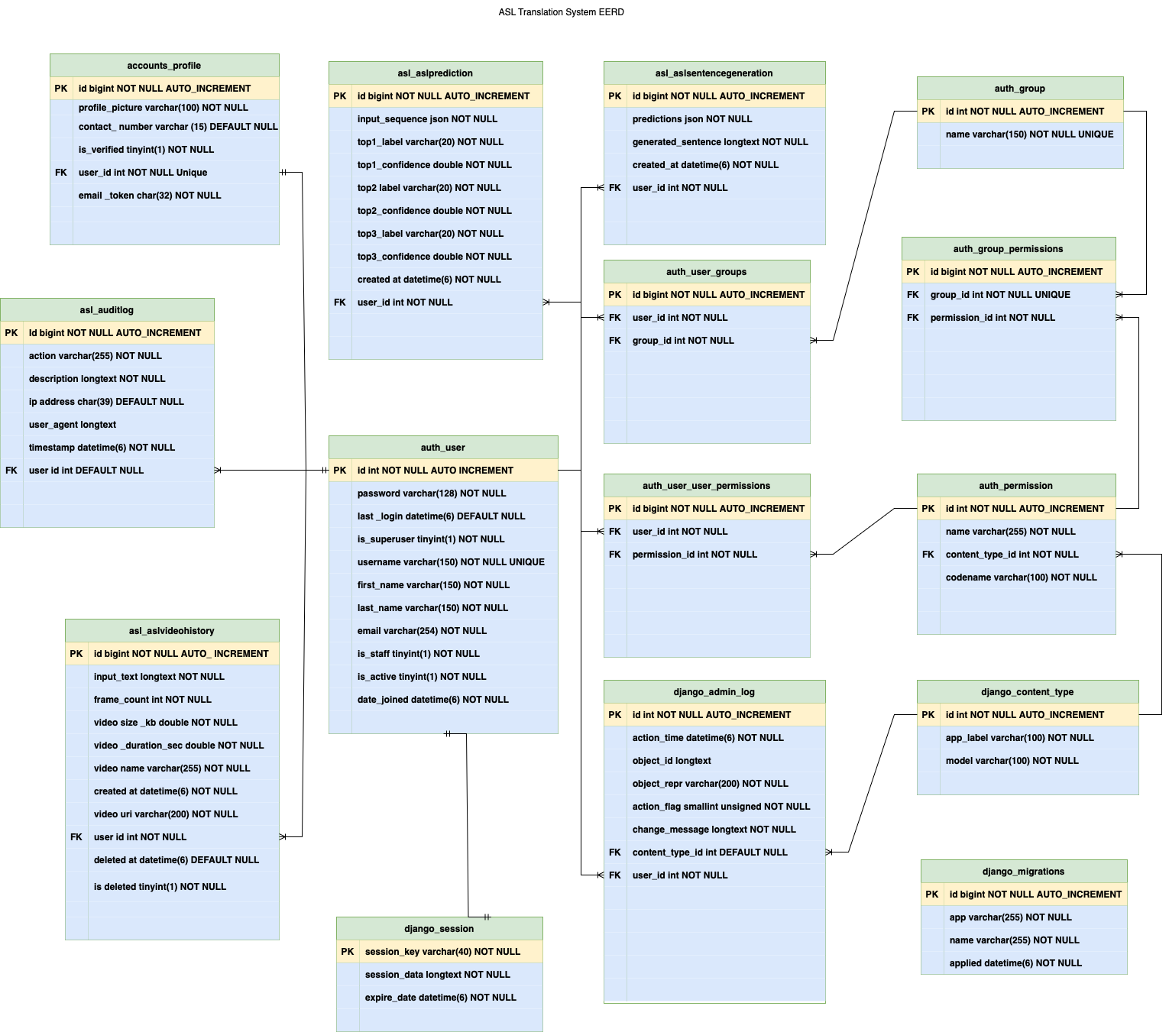
EERD

Slide 34
Product Overview
An AI-driven, real-time bidirectional ASL ↔ English translation platform that empowers Deaf/mute and hearing users to communicate seamlessly.
Core Technology: Leverages MediaPipe Hands for 21-point hand-landmark detection at 30+ FPS and an attention-augmented LSTM model for >99% gesture recognition accuracy with sub-200 ms latency.
Full-Stack Solution: Built with a BOOTSTRAP frontend, Django REST backend, and optional Expo-based mobile app—delivering a responsive, user-friendly interface across devices.
Rich Feature Set: Includes live text-to-speech and speech-to-text integration, avatar-based or clip-concatenation ASL video output, and role-based access control with secure authentication.

Slide 35
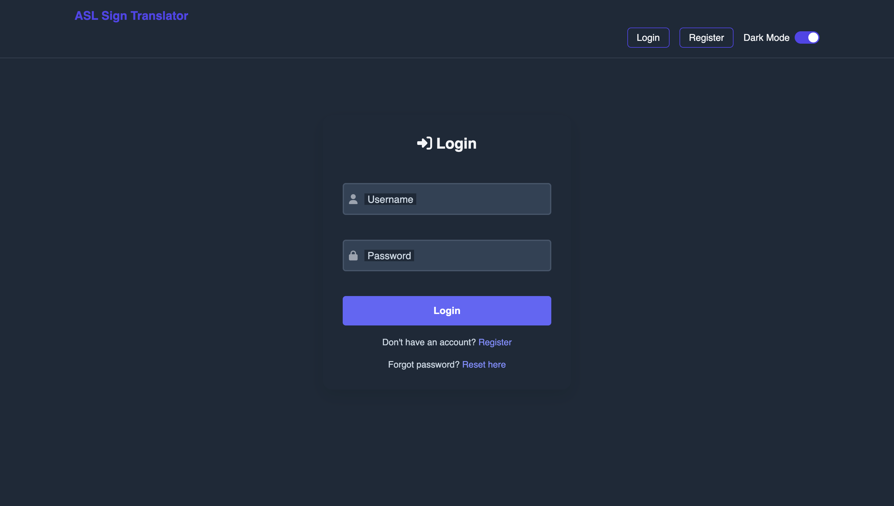
LOGIN

Slide 36
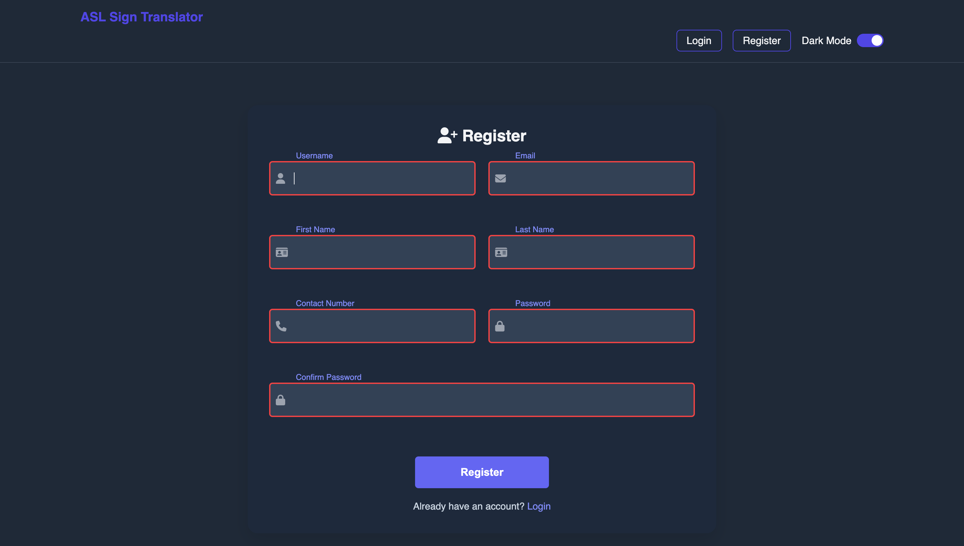
REGISTER

Slide 37
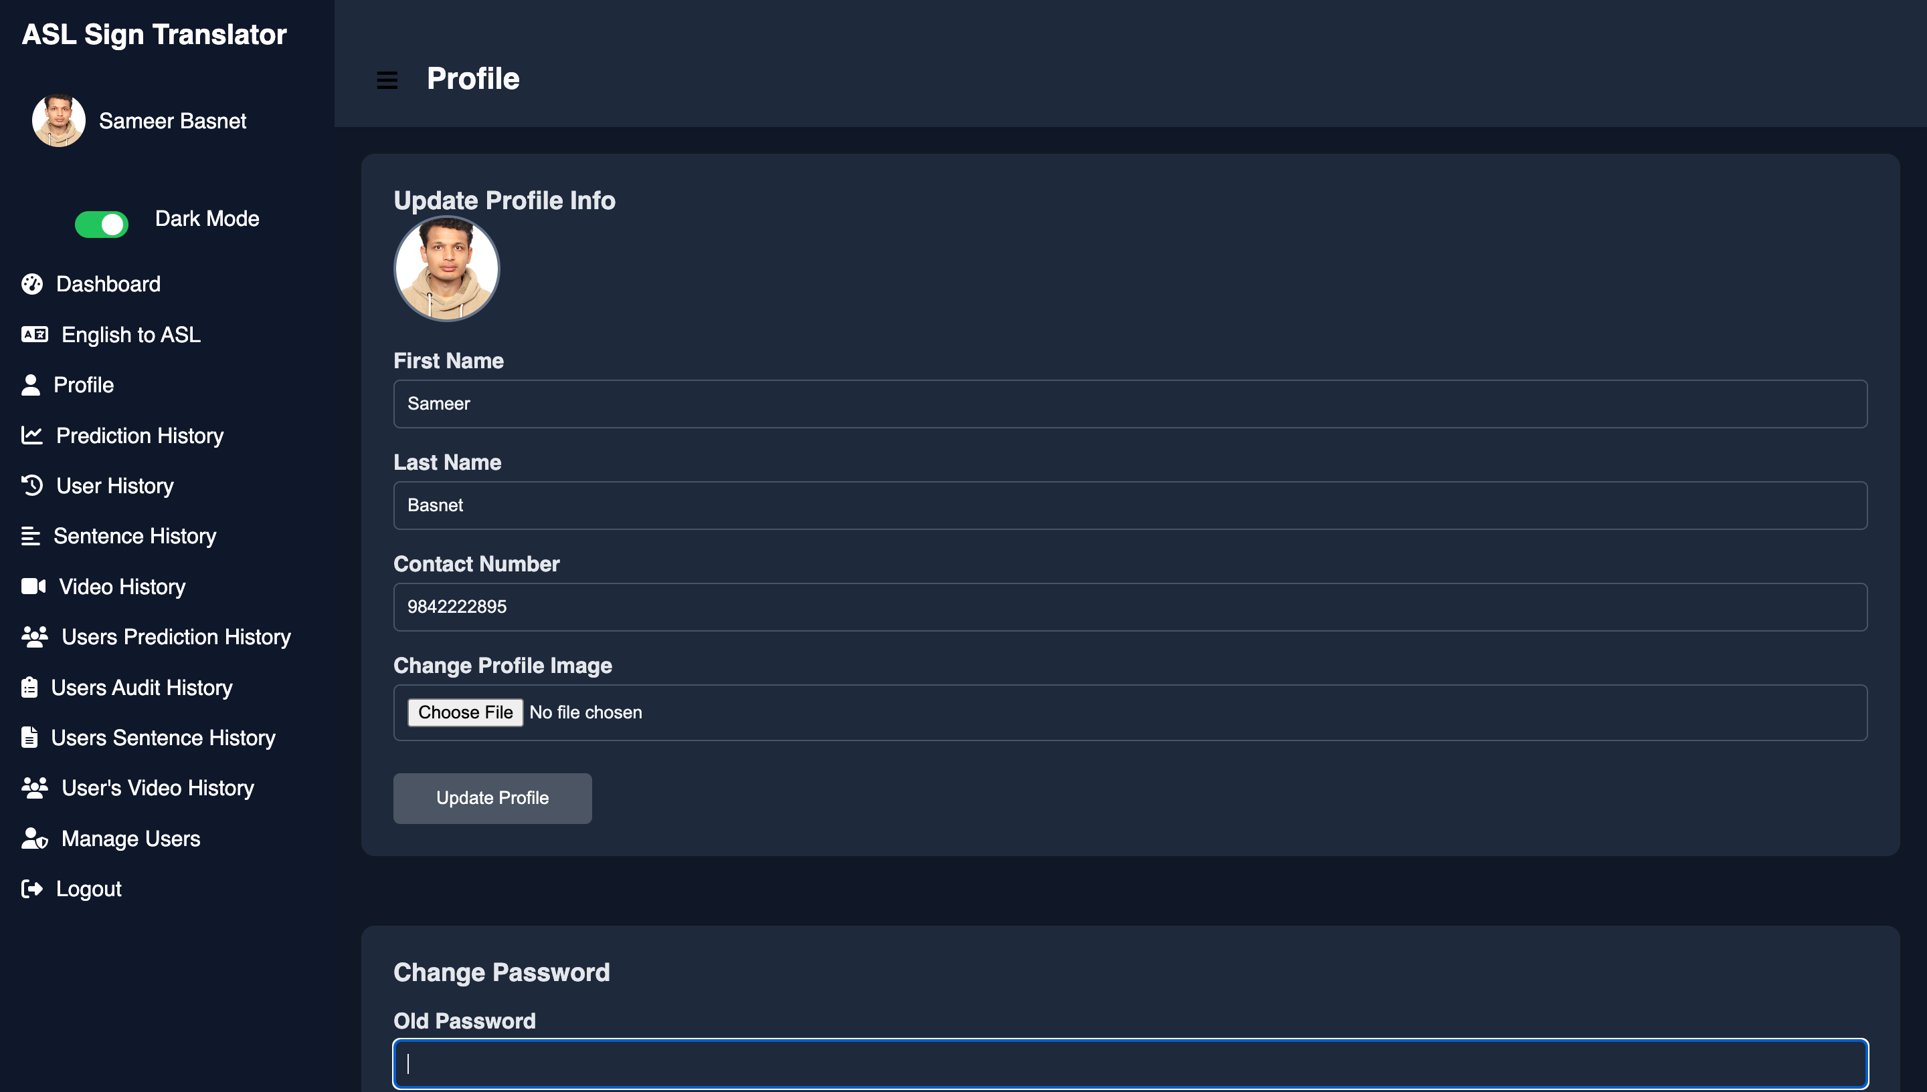
PROFILE

Slide 38
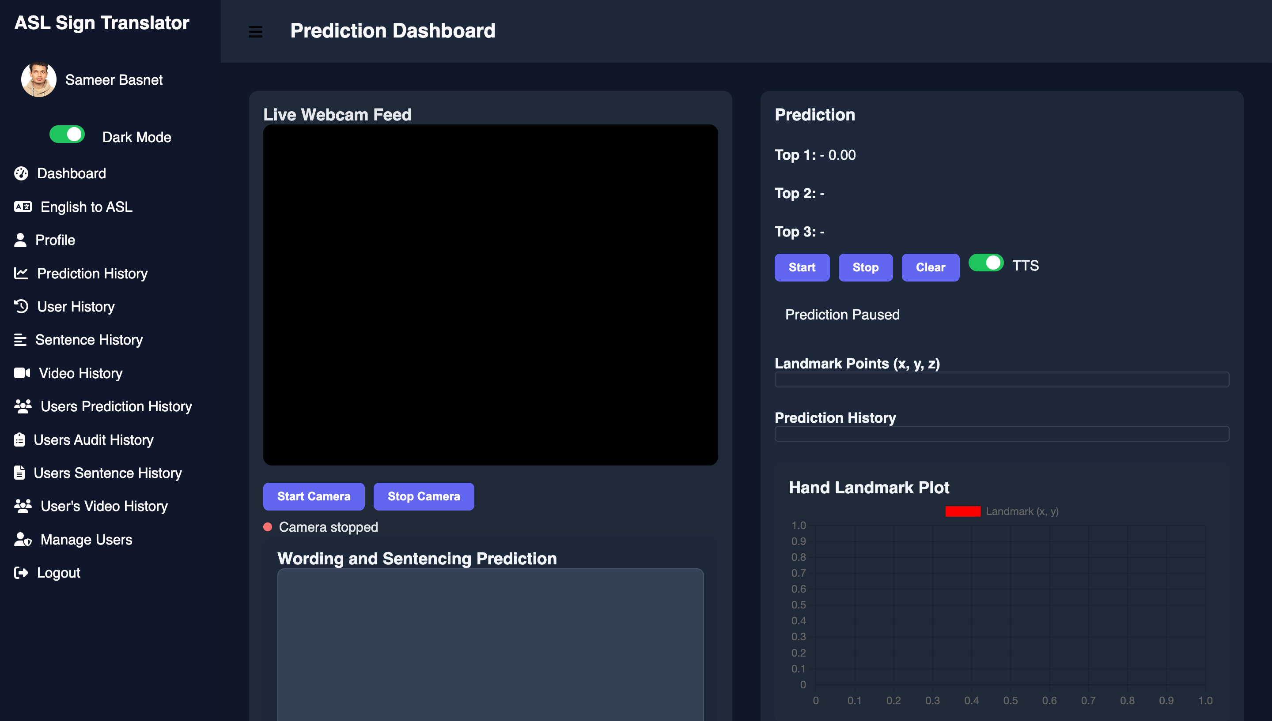
PREDICTION DASHBOARD

Slide 39
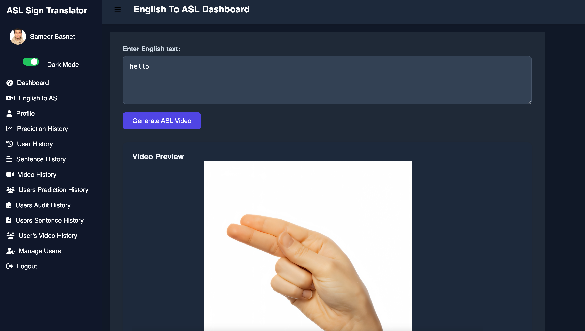
ENGLISH TO ASL DASHBOARD

Slide 40
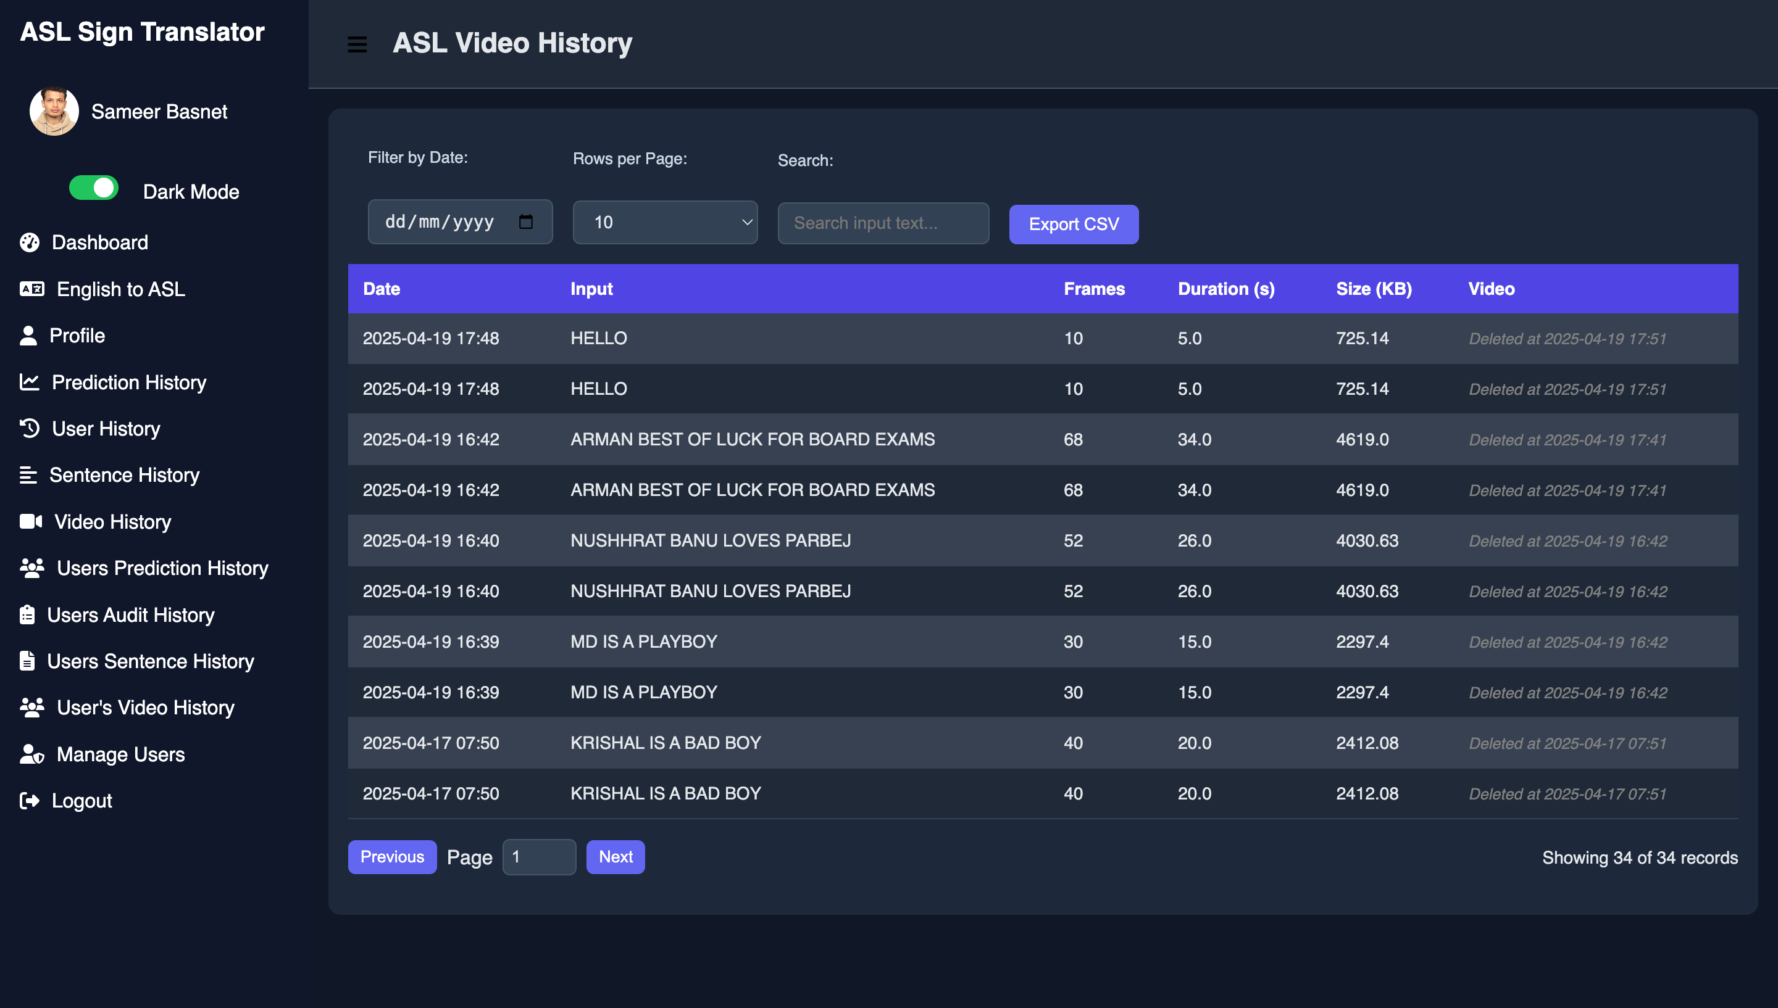
ASL VIDEO HISTORY

Slide 41
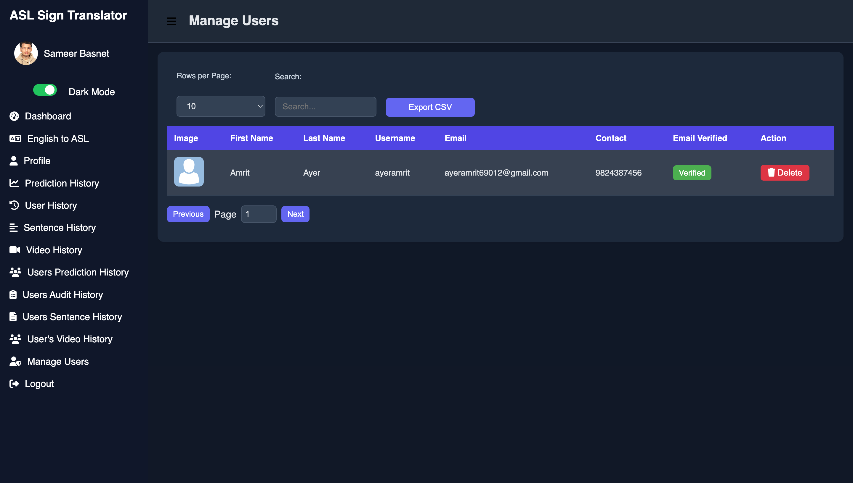
MANAGE USERS

Slide 42
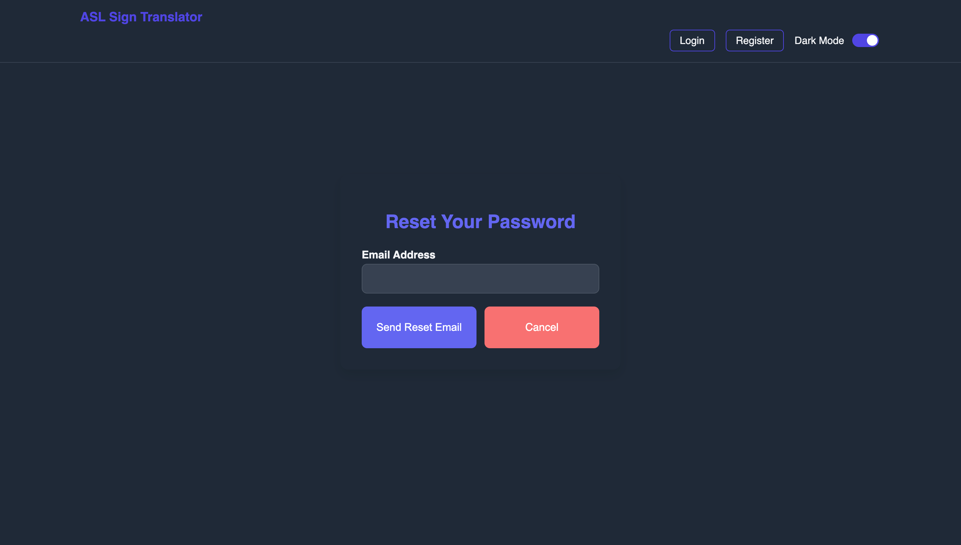
PASSWORD RESET

Slide 43
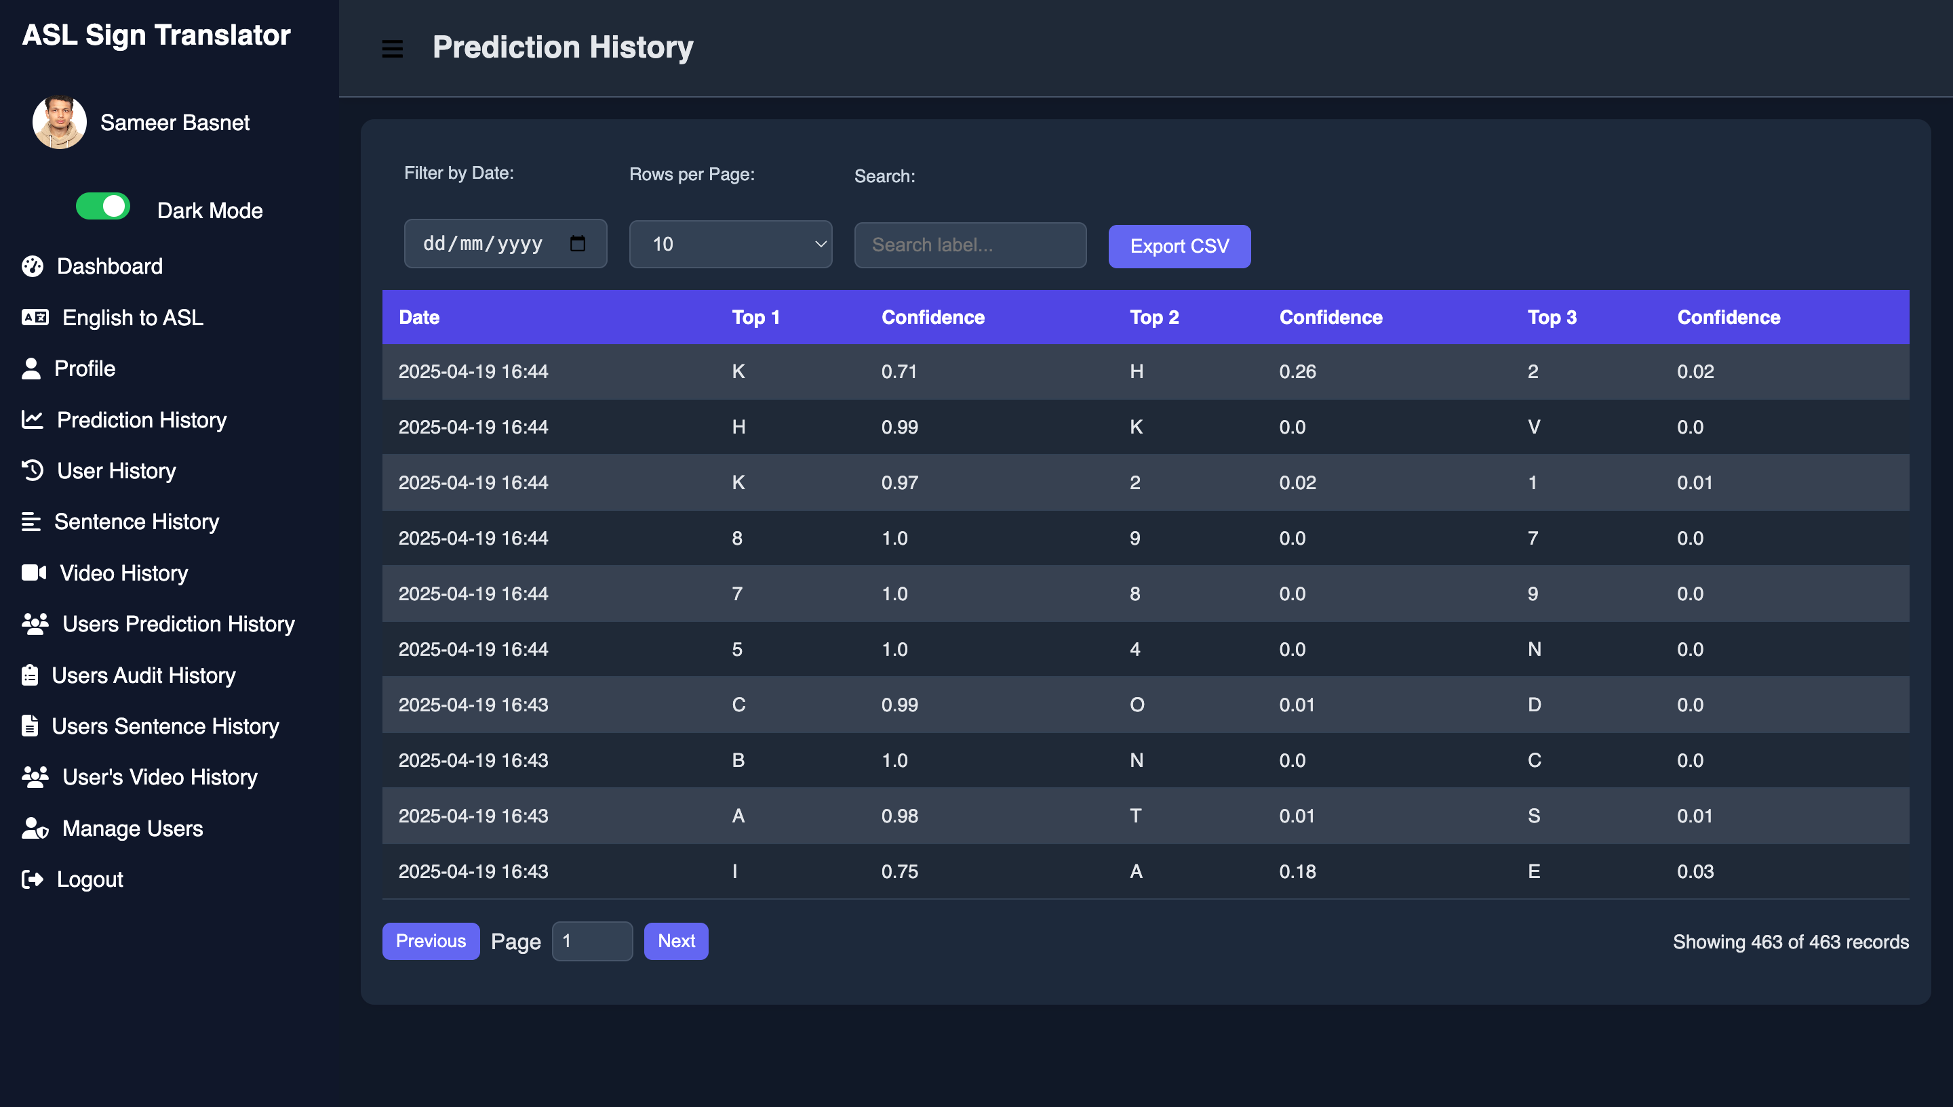
PREDICTION HISTORY

Slide 44
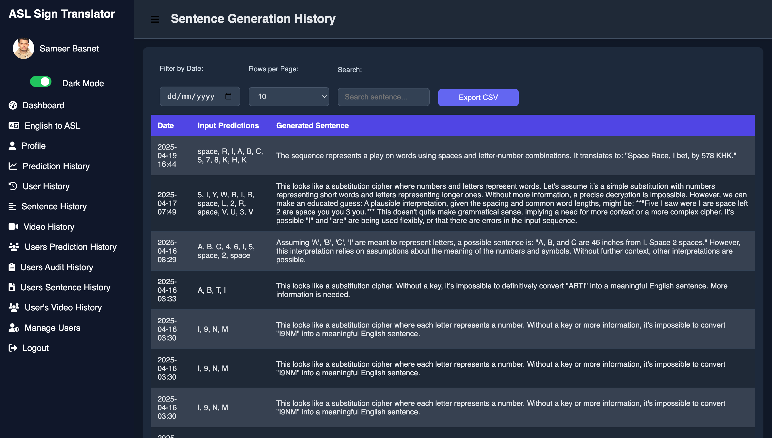
SENTENCE GENERATION HISTORY

Slide 45
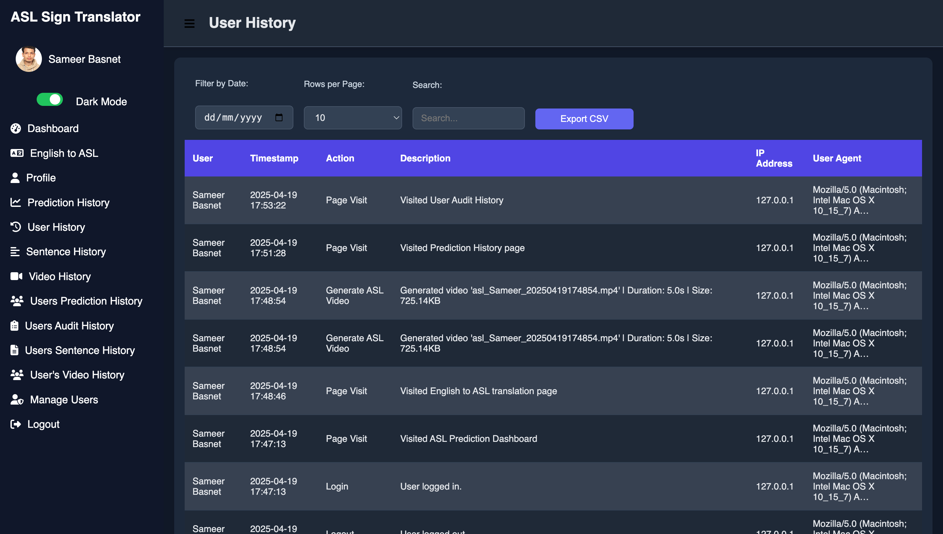
USER HISTORY

Slide 46
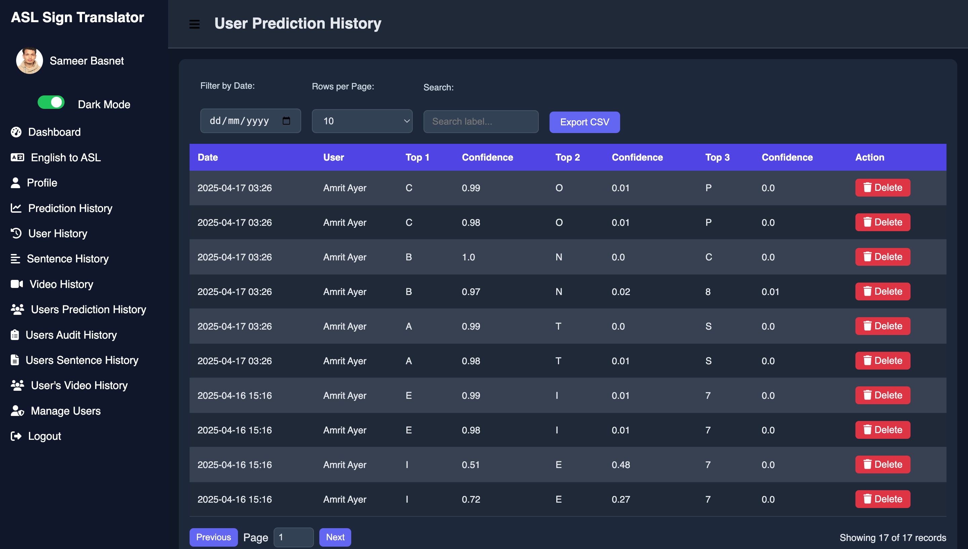
USER PREDICTION HISTORY

Slide 47
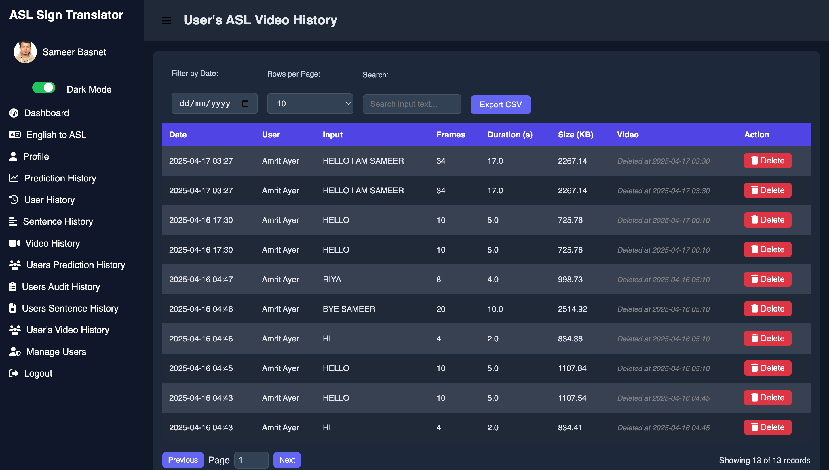
USER’S ASL VIDEO HISTORY

Slide 48
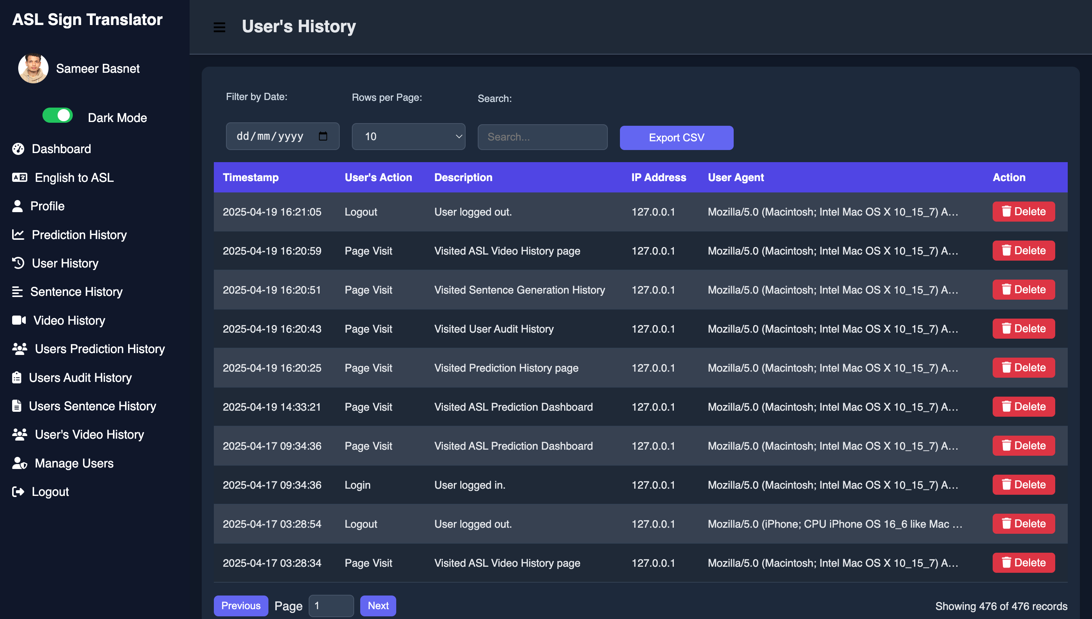
USER’S HISTORY

Slide 49
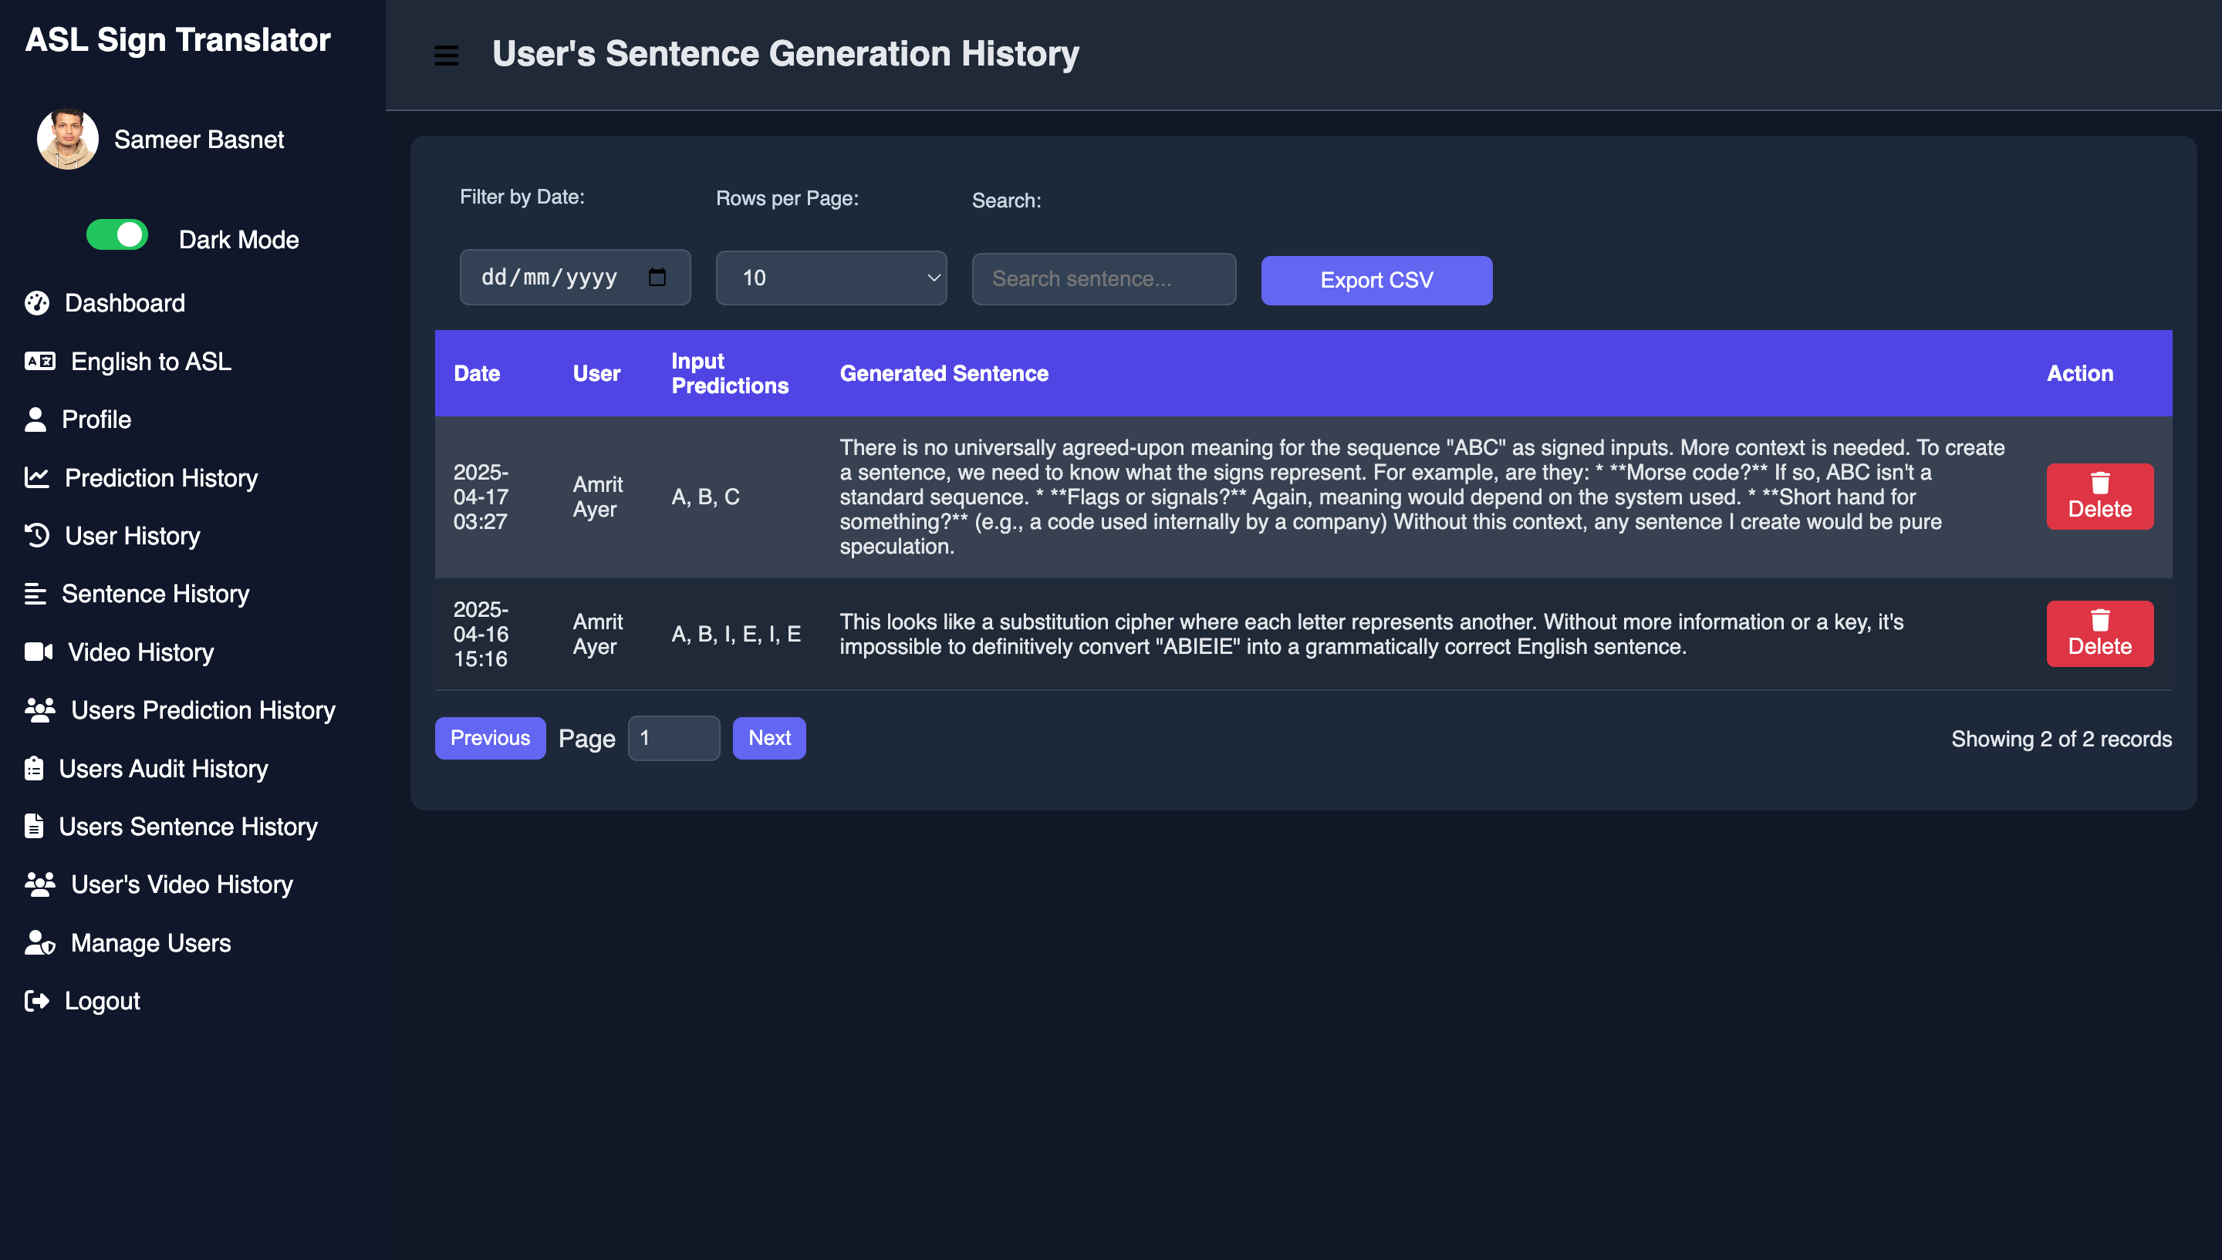
USER’S SENTENCE GENERATION HISTORY

Slide 50
Backend Overview
Django REST Framework API: Hosts endpoints for ASL→English inference and English→ASL video synthesis, handling incoming landmark data and text requests.
Model Serving: Loads the attention-augmented LSTM model (TensorFlow/Keras) at startup for low-latency, in-memory inference on gesture sequences.
MySQL Database:: Uses Django ORM to manage user profiles, role-based permissions, translation transcripts, and immutable audit logs.

Slide 51
Frontend Overview
React.js Single-Page Application: Provides a responsive UI with live camera feed, landmark-overlay canvas, and control buttons for starting/stopping translation.
MediaPipe Hands Integration: Runs in-browser via the MediaPipe JavaScript API to extract 21 hand landmarks at 30+ FPS, superimposed on the video preview.
Real-Time Transcript & Video Display: Shows recognized English text live below the video, offers text-to-speech playback, and renders English→ASL avatar or clip-based videos inline.
Web Speech API Support: Enables optional speech-to-text input and synthesized speech output for full bidirectional communication.
Responsive & Accessible Design: Mobile-first layouts adapt to desktops, tablets, and phones, with ARIA labels, high-contrast themes, and clear user guidance for camera alignment.

Slide 52
Future Enhancements
End-to-End Transformer Translation: Replace the LSTM pipeline with a transformer-based seq2seq model to handle full sentences and complex ASL grammar in one pass.
Multimodal Non-Manual Marker Support: Integrate facial-expression and body-posture detection alongside hand landmarks to capture non-manual ASL cues for richer, more accurate translation.
Offline & On-Device Inference: Quantize and optimize models (e.g., TensorFlow Lite) for real-time translation on mobile phones and edge devices without requiring a network connection.
Multilingual Sign Language Expansion: Leverage transfer learning to add support for other sign languages (e.g., BSL, ISL) and regional ASL dialects, making the platform globally inclusive.
High-Fidelity Avatar Animation: Advance the ASL video output with 3D avatars that smoothly animate both manual signs and facial/body expressions, ensuring natural, continuous signing.

Slide 53
Thank You
END OF PRESENTATION

